Slide 1

FAQ- Subaward Modification Transaction

Slide 2
Why can’t I select multiple subs on the subs picker page in eAward?
Each subsite requires it’s own unique subaward modification transaction request. As subaward information and the execution timelines can differ for each subsite.

Slide 3
What if a Subsite is not listed in eAward?
Check Ushop
  Was the subaward processed under the DSS?
  Was the subsites name incorrectly entered?
  Clear your browsers cache and cookies

Slide 4
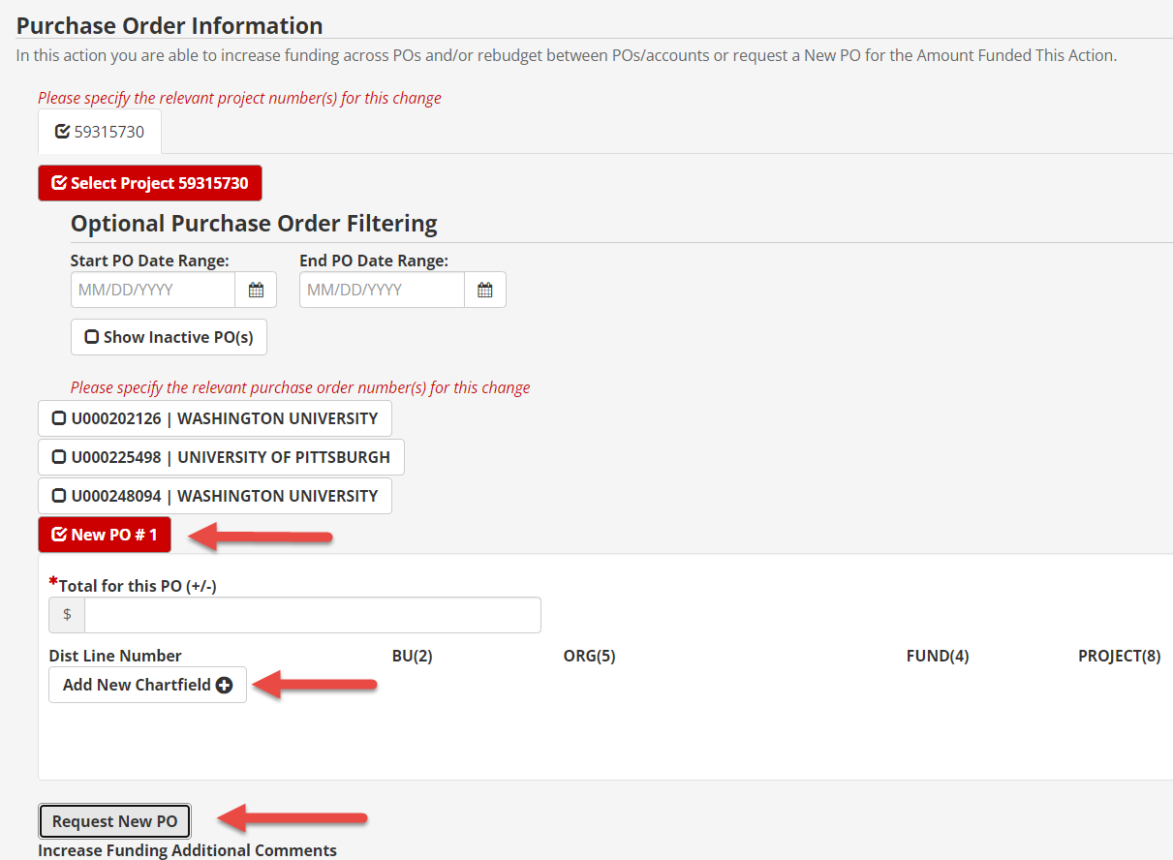
What if a PO is not listed in eAward?
It is possible this is a legacy PO meaning it was created prior to the DSS/subaward number updated in Ushop.
  In this case the PO information will need to be added manually in eAward:
  →Request New PO
  → Add Chartfield
  Multiple New PO’s can be requested
  Note: A DSS# cannot be added retroactively in uShop, but will update once a new PO request listing the DSS# has been processed in Ushop.

Slide 5
What if the project number is closed for a PO?
Ushop:
If the project number that is to be used for a new PO setup is closed, OSP can not set up the PO for this project. Contact Kristie Thompson (OSP) who will work with Purchasing and GCA to create a new PO.
If the project number is closed and a PO needs to be modified, OSP can create this continuation request but it will need to be processed with Kristie and Randi Ruff.

Slide 6
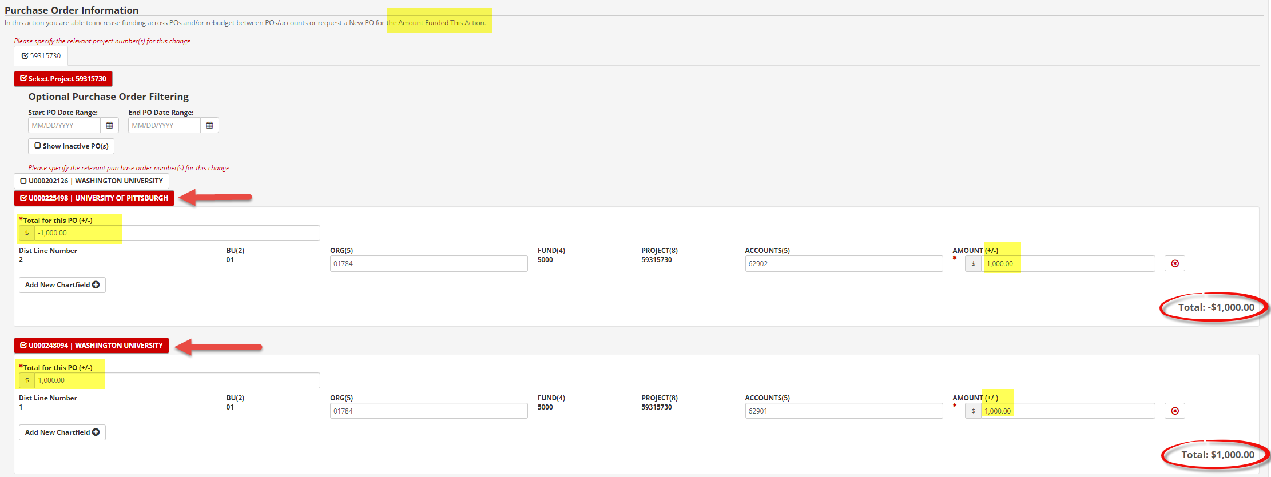
How do I rebudget between active PO’s?
Select subsite PO’s
Enter minus (-) and dollar amount to be deducted
Enter plus (+) and dollar amount to be added
You can only rebudget for the amount funded this action.
Use same account codes –see slide on how to disencumber funding on PO’s

Slide 7
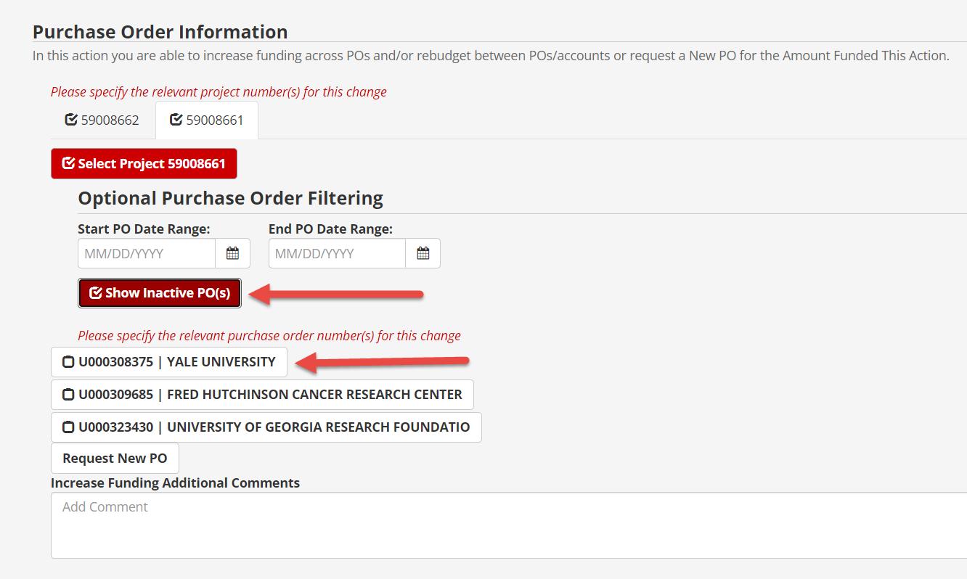
How do I rebudget from current/active to closed/inactive PO?
Select closed and current PO(s)
For example:
Enter minus (-) and dollar amount to be deducted on current PO
Enter plus (+) and dollar amount to be added to closed PO
You can only rebudget for the amount funded this action!
Note:
If a project number is closed create PO continuation in Ushop for this rebudget and send it to Kristie to "Assign" it to Randi.
Check both project# tabs for PO information and requests by user

Slide 8
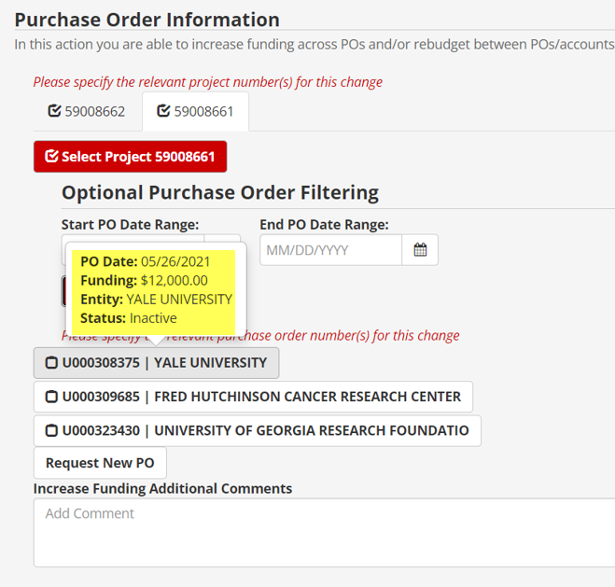
How can I see PO specific information?
Hovering over the PO# will provide:
→PO Date
→Funding amount
→Entity name
→Status

Slide 9
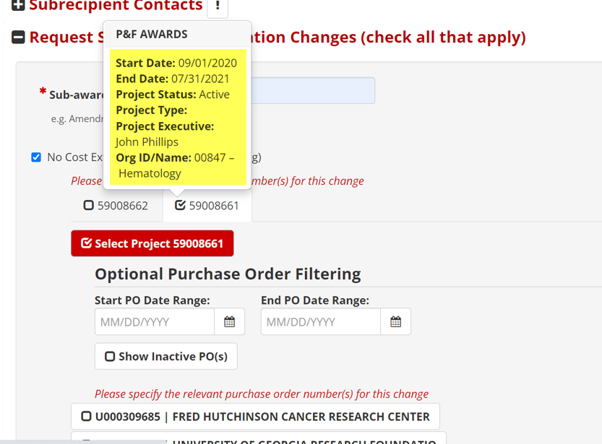
How can I see project number specific information?
Hovering over the project# will provide:
→End Date
→Project Status
→Project Type:
→Project Executive (PE)
→Org ID/Name

Slide 10
Carryforward approved-
New PO or PO Continuation?
New PO
→Initial Subaward
→Change of Address for Subsite
→Change of Name for Subsite
→Revoke Carry Forward and add a new Budget Period
→Update Project Number for subaward
PO Continuation
→Add/Decrease Funding
→Add/Decrease Time
→Change of PI (U or Sub)
→Any random modifications such as account codes, errors in data entered, etc. (NOTE if we need to change PROJECT Numbers, we will have to create a new PO)

Slide 11
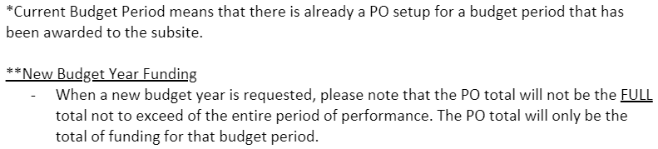
Carryforward restricted-
New PO or PO Continuation?
New PO
→Initial Subaward
→Adding New Budget Periods**
→Change of Address for Subsite
→Change of Name for Subsite
→Update Project Number for Subaward
PO Continuation
→Add/Decrease Funding for a Current Budget Period*
→Carry Forward of Funding from previous budget period to a Current Budget Period*
→Add/Decrease Time for a Current Budget Period*
→Change of PI (U or Sub)
→Carry forward approval is granted for the subaward
→Any random modifications to existing PO such as account codes, errors in data entered, etc. (NOTE if we need to change PROJECT Numbers, we will have to create a new PO)

Slide 12
How to disencumber funding on PO’s?
If the subaward is carrying forward funding from one PO to a new PO and the first PO is not going to be closed, OSP will need to disencumber the funding that has been moved.
If the subaward is carrying forward funding from one PO to a new PO and the first PO is going to be closed, no OSP action required. The PO being closed this will automatically disencumber that funding.

Slide 13
Budget Account Code Description
Sub awards under $25,000
Account Code: 62800-62869
The first $25,000 of expenditures, in Grands and Contracts (Fund 5000), on each sub award initiated by the University with outside contracting entities. Expenditures exceeding $25,000 should be recorded in account range 62900-6269
Sub awards over $25,000
Account Code 62900-62969
Expenditures in Grants and Contracts (Fund 5000), exceeding the first $25,000 on each sub award initiated by the University with outside contracting entities.
https://fbs.admin.utah.edu/gca/gca-forms/#cat

