Slide 1

FCOI Validation-New Award Setup
2020
By Isabella Johnsen

Slide 2
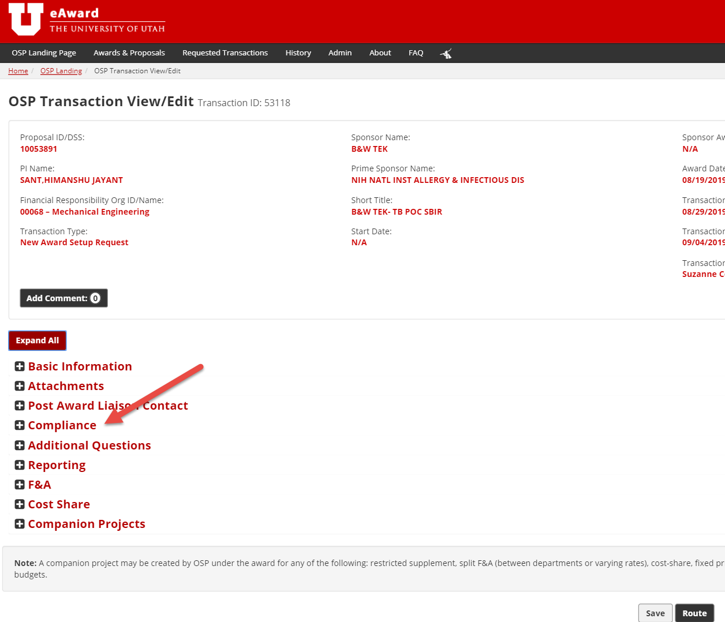
Where is the FCOI validation found?
Within the “Complinace” setion of the
New Award Setup transaction.

Slide 3
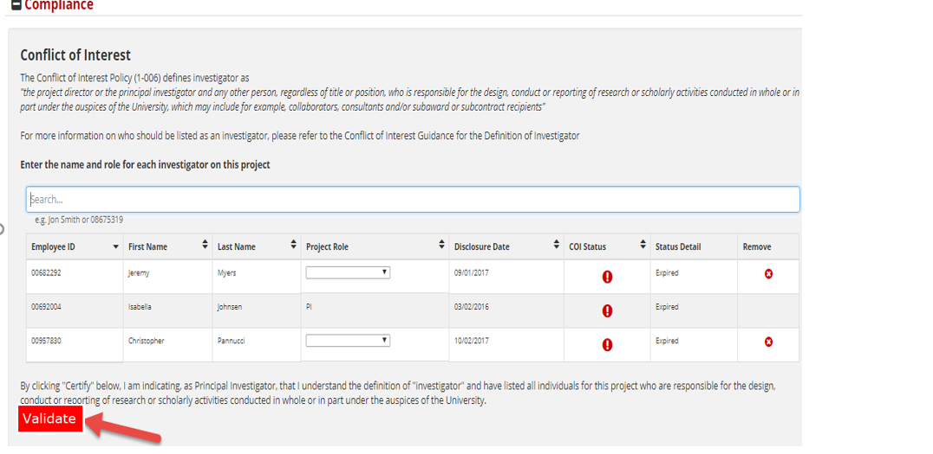
Who can validate the FCOI?
Only the PI has authority to validate.

Slide 4
How can I (PI) get to the validation section?
Option 1:
  Follow URL in the “Action Required” email notification you received. This will bring you directly to the FCOI validate section.
Option 2:
  Login to CIS
  Select Researcher from dropdown
  Select eAward
  Go to Requested Transaction Page
  Select appropriate DSS
  Navigate to Compliance section

Slide 5
I (PI) previously listed the key personnel in eProposal at proposal time, will it prepopulate in eAward?
Issuence of an award typically takes month. To ensure correct key personnel is listed at award setup time reentering in eAward is necessary.

Slide 6
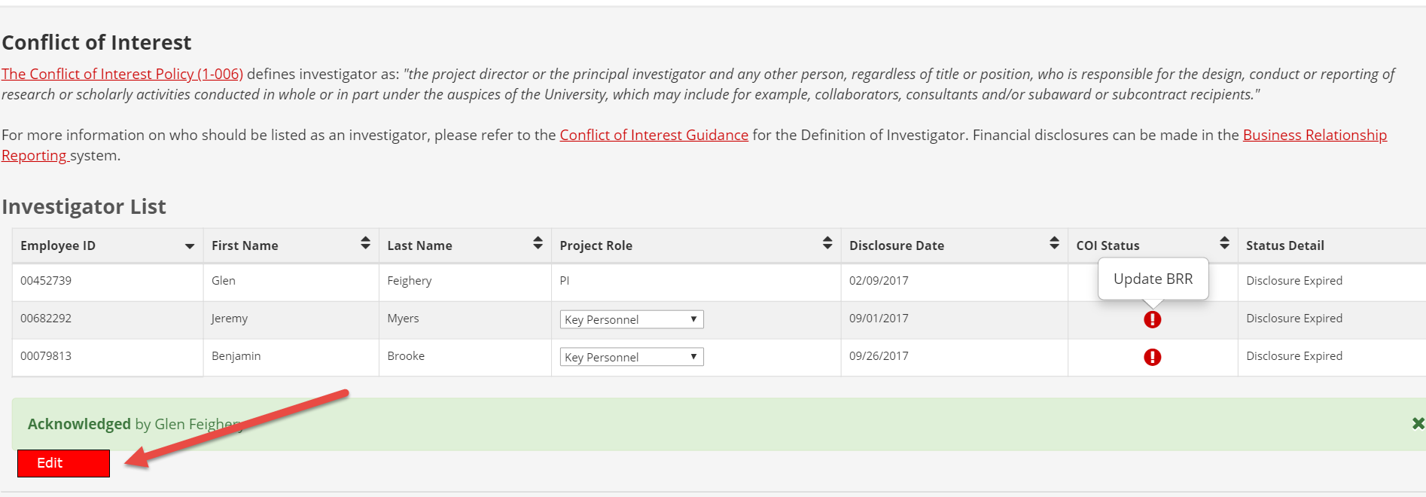
Who can edit the Investigator list?
Only the PI has authority to edit.

Slide 7
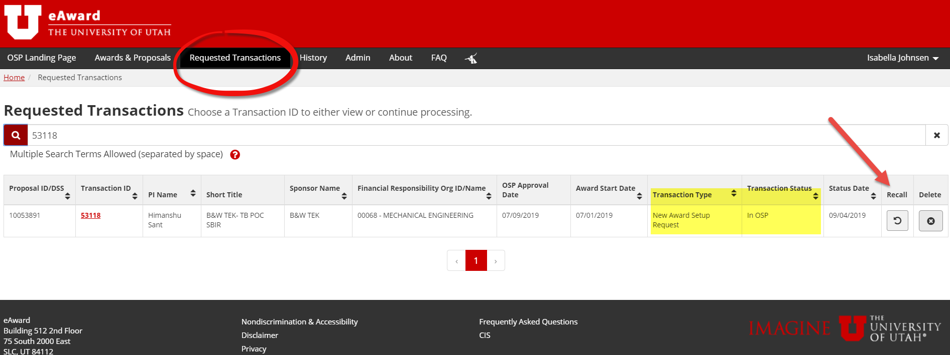
Can I (PI) edit the Investigator list when eAward status is “In OSP”?
No. Recall transaction back to draft, update and resubmit.

Slide 8
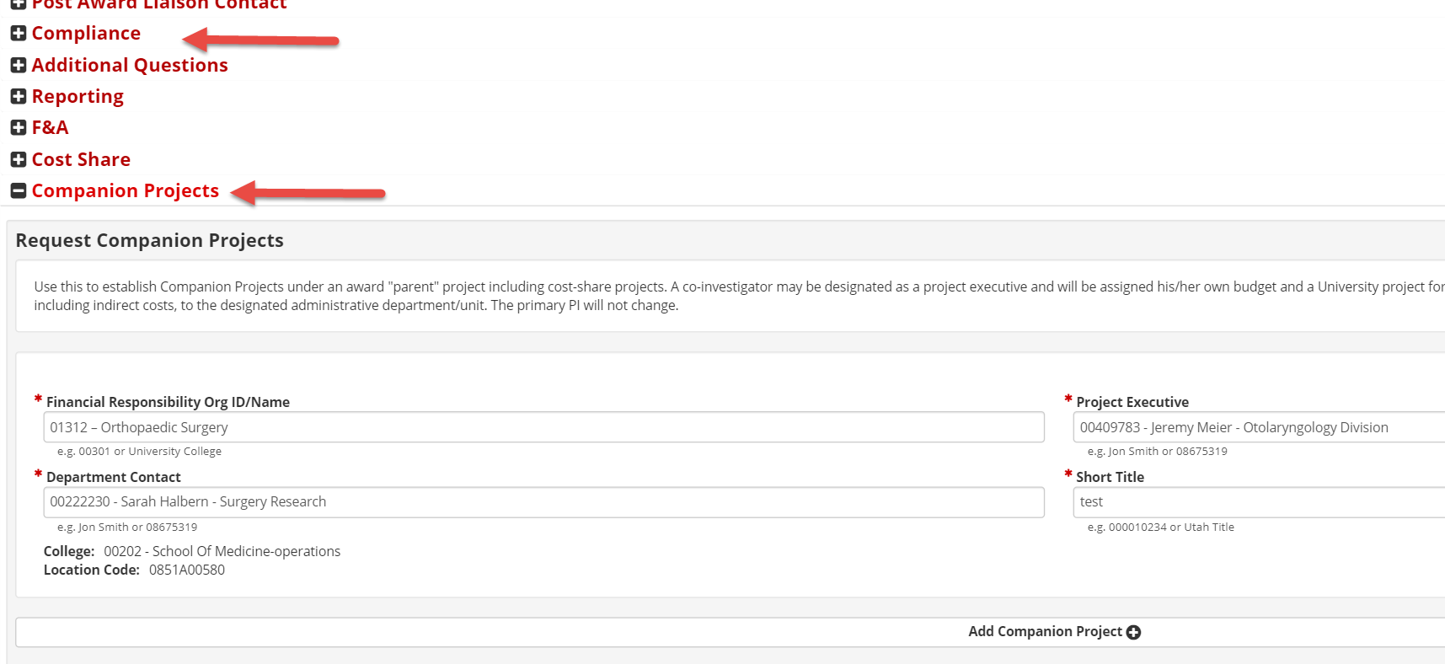
I am requesting a companion project do I (PI) have to list the Project Executive (PE) in the compliance section?
The PE will be automatically added.

Slide 9
What email notifications can I (PI) expect?
Initial email requesting FCOI validation after transaction has been submitted.
  eAward status: “Pending PI Validation”
A reminder email every three (3) business days.
  eAward status: “Pending PI Validation”
After validation, if a FCOI status other than green has been displayed, an email is sent to the PI, Creator and Investigators with further instructions.
  eAward status: “Pending COI”

Slide 10
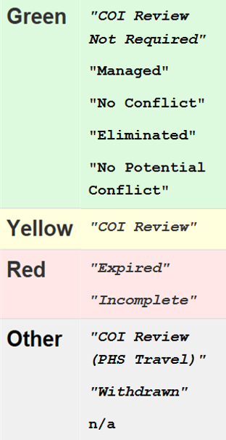
What FCOI statuses can I (PI) expect?

Slide 11
Will I (PI) get reminder emails if eAward status is “Pending COI”?
If FCOI status is retuned yellow, red, or other no email reminders will be generated to the PI since the COI review can take weeks.
Note: If questions, while eAwad status is “Pending COI”, please contact the COI compliance office directly.

Slide 12
The validation returned all green FCOI statuses, what next?
Congratulations!
Your transaction is now “In OSP” for review & further processing with Grants and Contract Accounting.
Please allow up to 10 business days for processing and a project number(s) to be issued.
You can follow your transactions status for updates.

Slide 13
Thank you!

